Slide 1
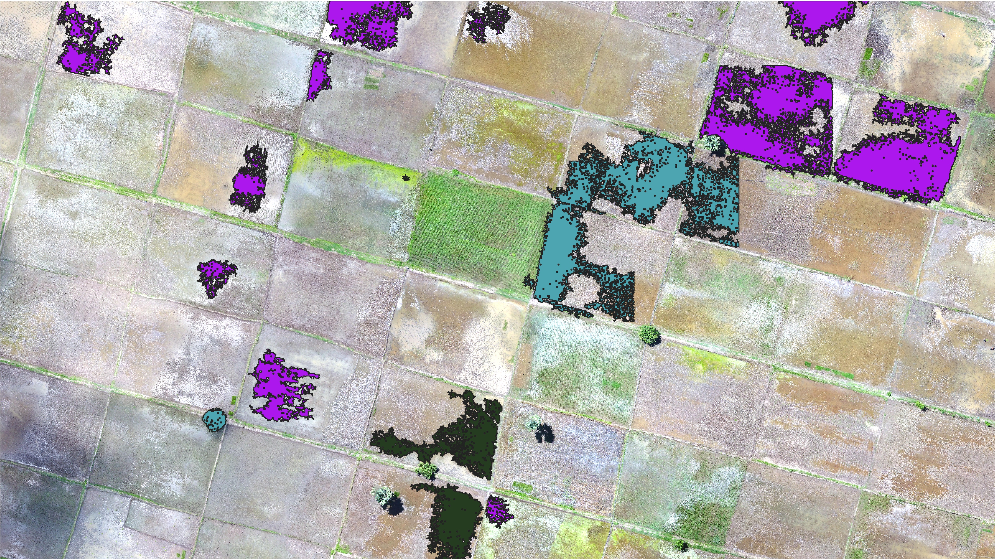

The Region Growing Plugin
Greg Oakes

Slide 2
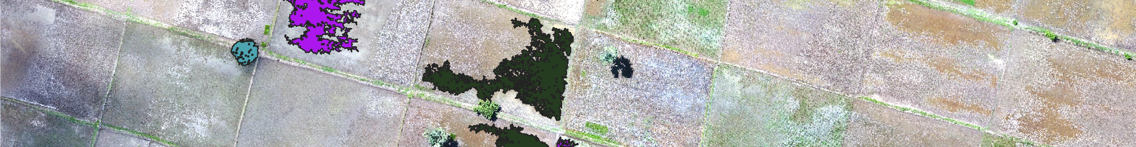
Purpose
The purpose of this QGIS Plugin is to allow a user to click anywhere within an RGB drone image and similarly coloured pixels ill automatically selected.
This provides a quick and easy way to generate training data which can be used for image classification.

Slide 3
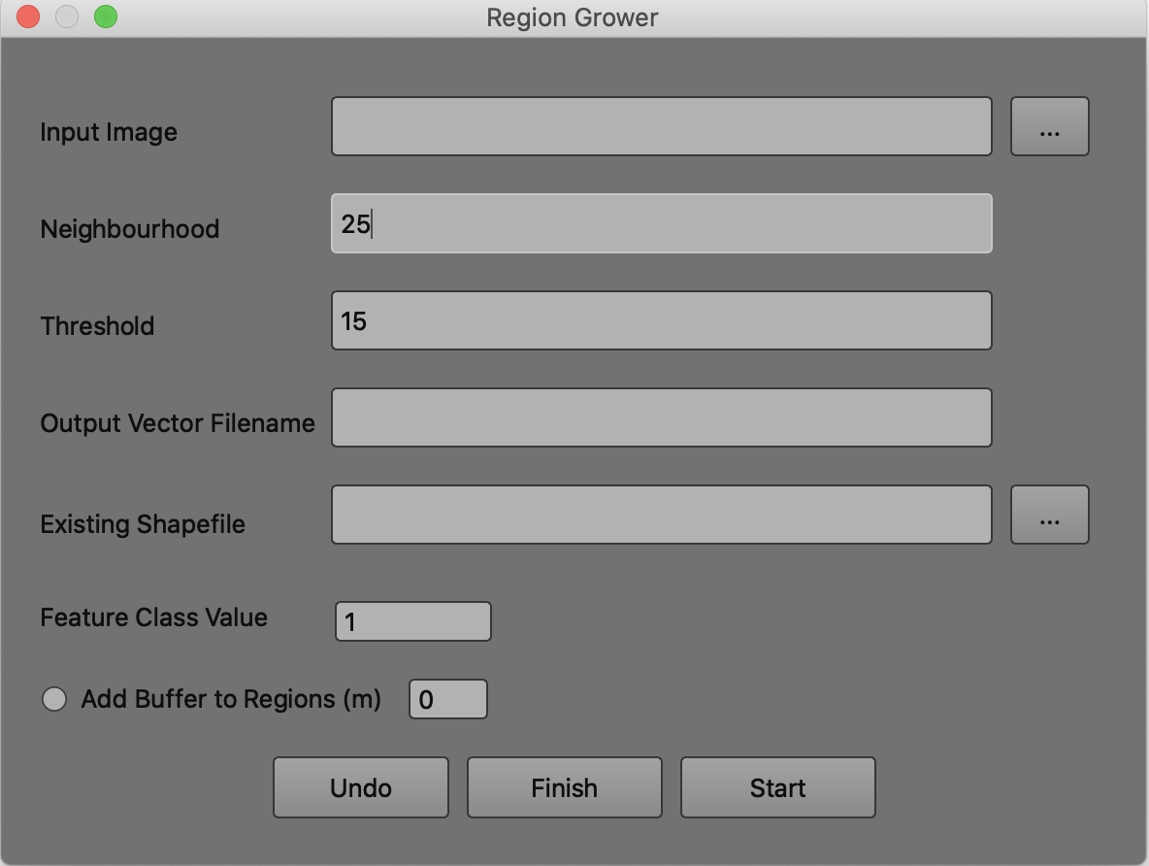
Main User Interface
Input RGB Drone Imagery
Size of the neighbourhood to grow around the clicked point to search for like pixels. Expressed in metres.
Like Pixel Threshold, a higher value will include more dissimilar pixels, a lower value gives a stricter selection of like pixels.
Output Vector filename. This will be saved ion the same directory as the input imagery.
An existing shapefile that you have started to digitise.

Slide 4
Main User Interface
Class value to add to the attribute table of the output dataset for the next feature to be digitised.
Create the final dataset and close plugin.
Add an optional buffer to each feature of a specified distance.
Start the region growing plugin.
Remove the previous feature.

Slide 5
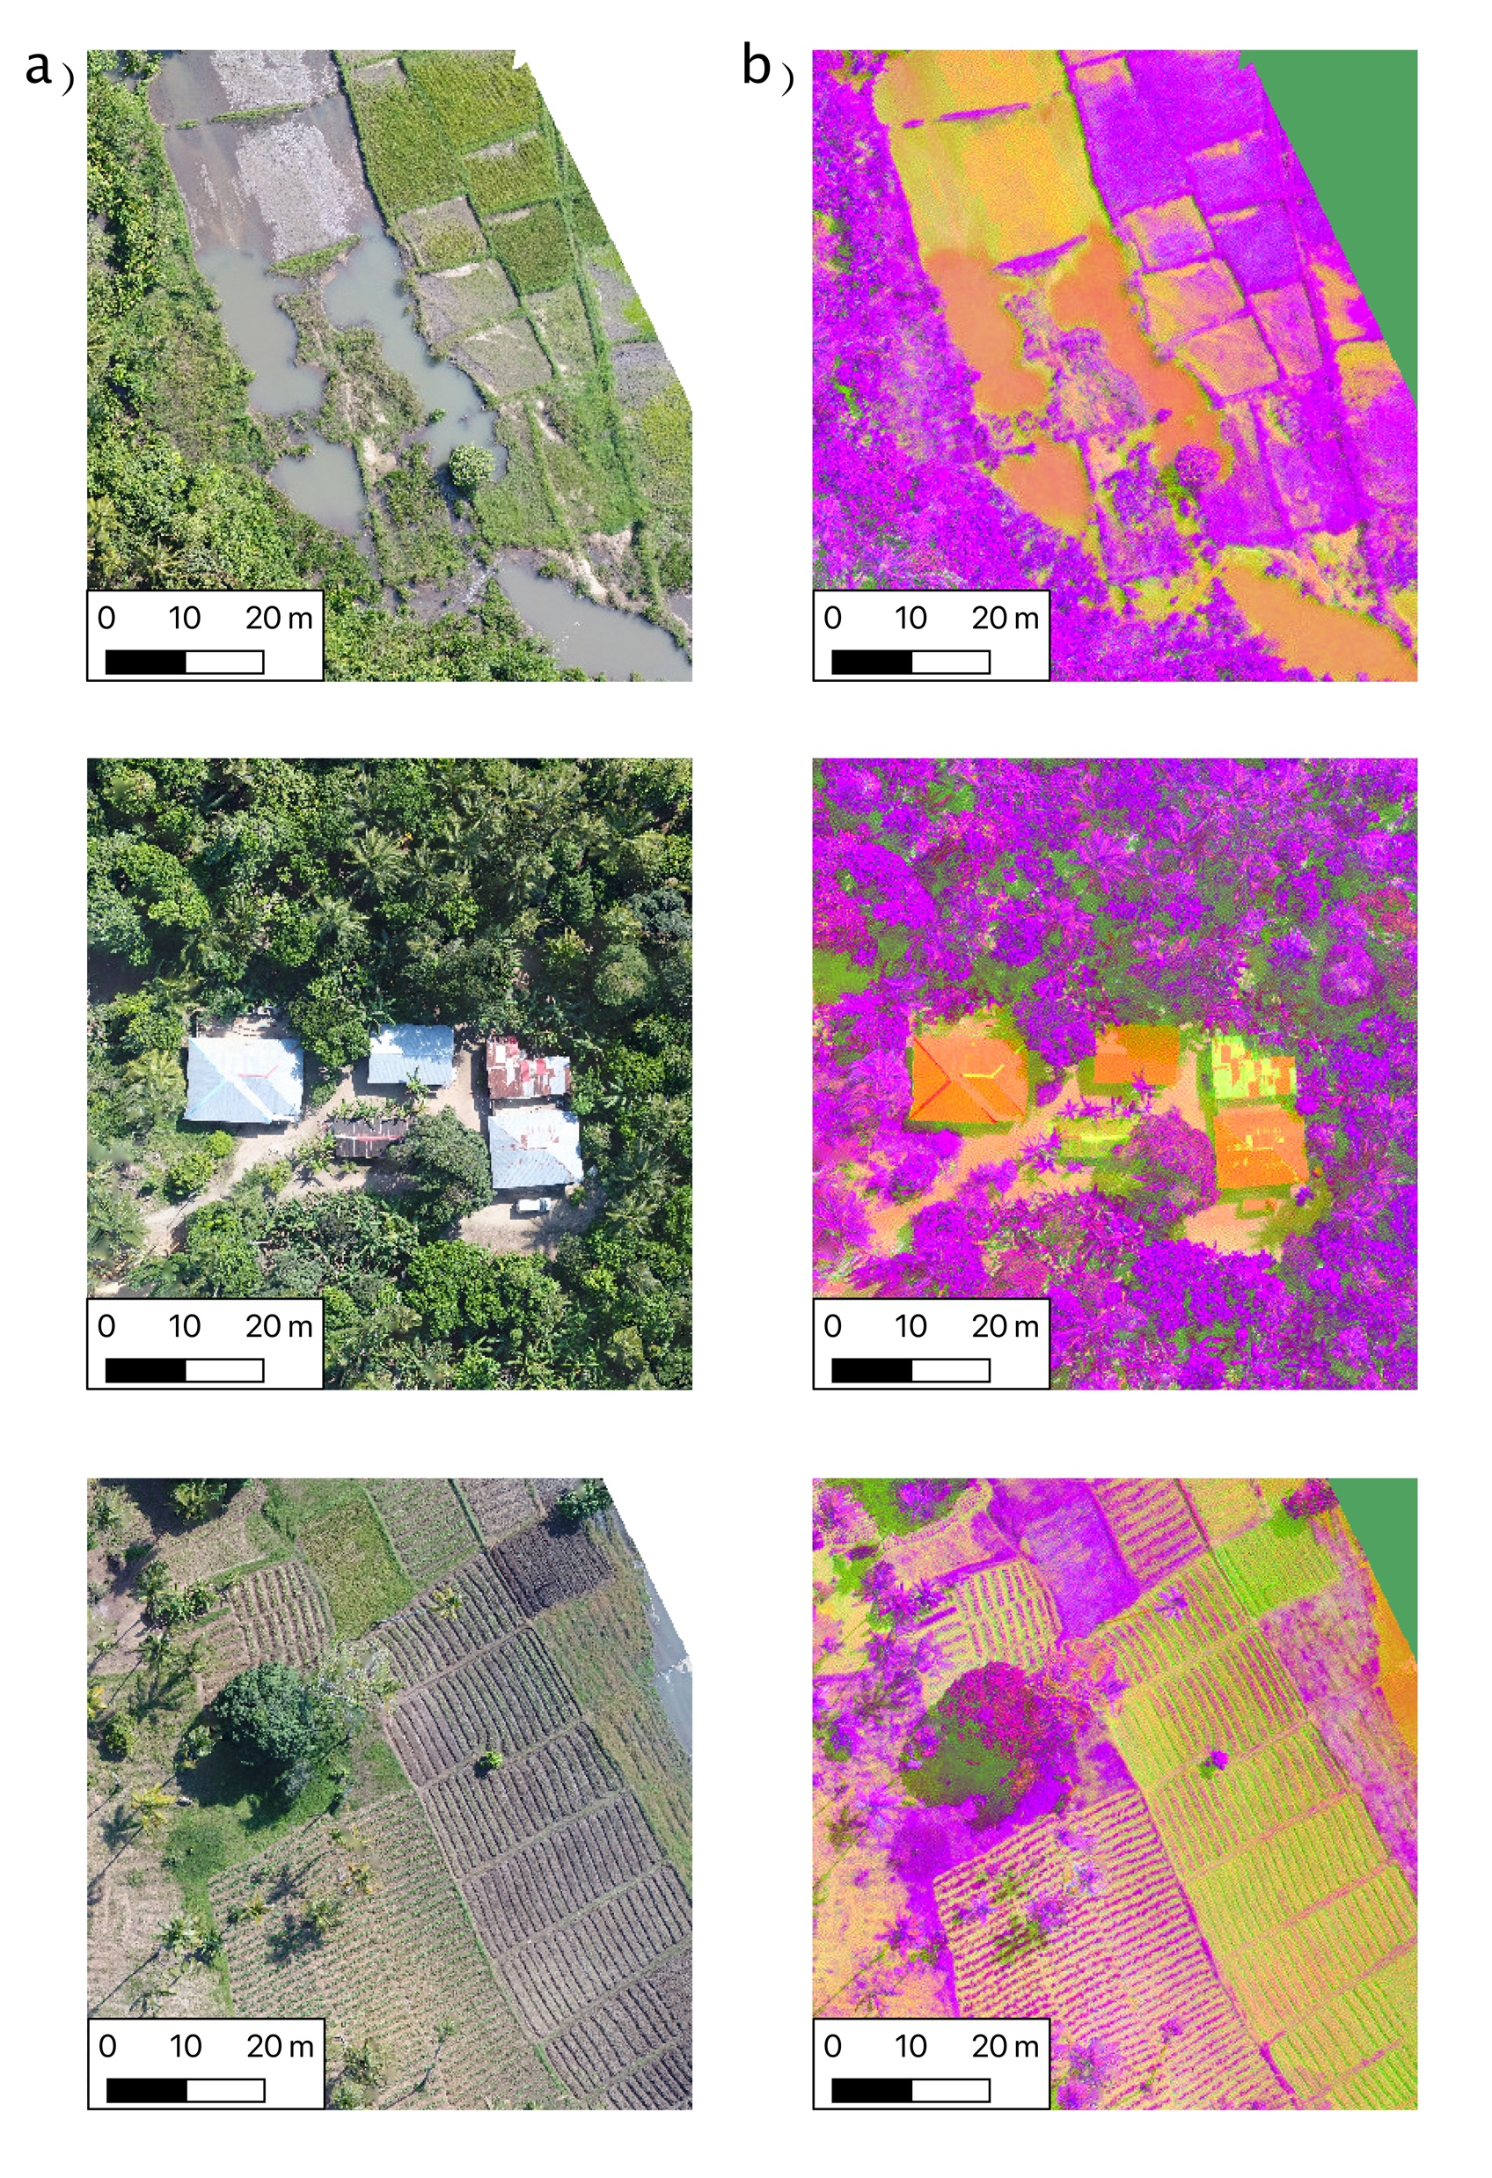
Principle Of Operation – LAB Colour Transformation
RGB drone imagery is transformed into an LAB colour space, but still displayed to the user as RGB
An LAB colour space allows for each pixel to be represented in an XYZ coordinate system.
The LAB colour space is different to RGB as pixels values are a component of:
L = Lightness between 0 - 100
A = Position on a Green – Red Spectrum
B = Position on a Yellow – Blue Spectrum

Slide 6
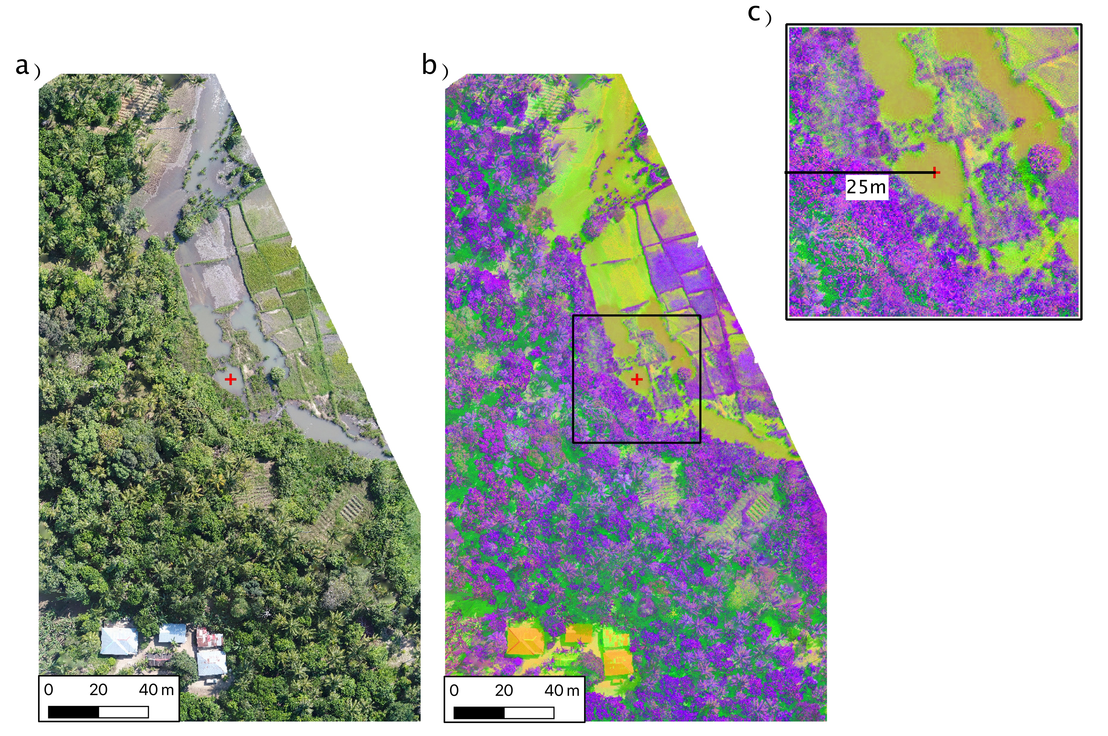
Principle Of Operation – Neighbourhood Window
When a user clicks the map a subset of the LAB image is formed.
The size of the window is defined by the user.
In this window is where like pixels will be found.

Slide 7
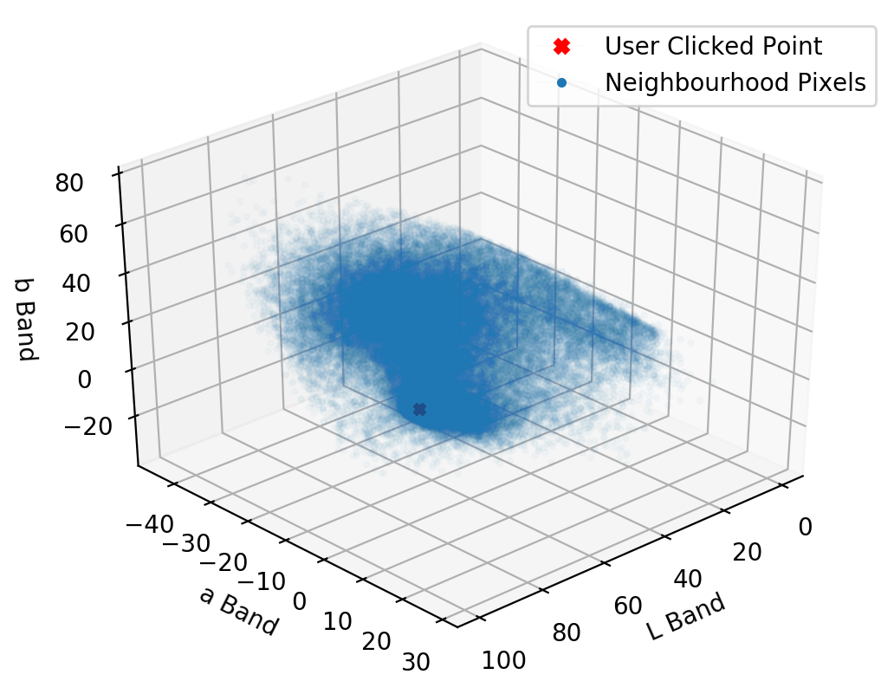
Principle Of Operation – LAB Feature Space
All pixels within the neighbourhood window are then plotted into an LAB feature space.
The LAB values of the pixel clicked by the user is also plotted.
The Euclidean distance between each pixel in the feature space and the pixel clicked by the user is calculated.

Slide 8
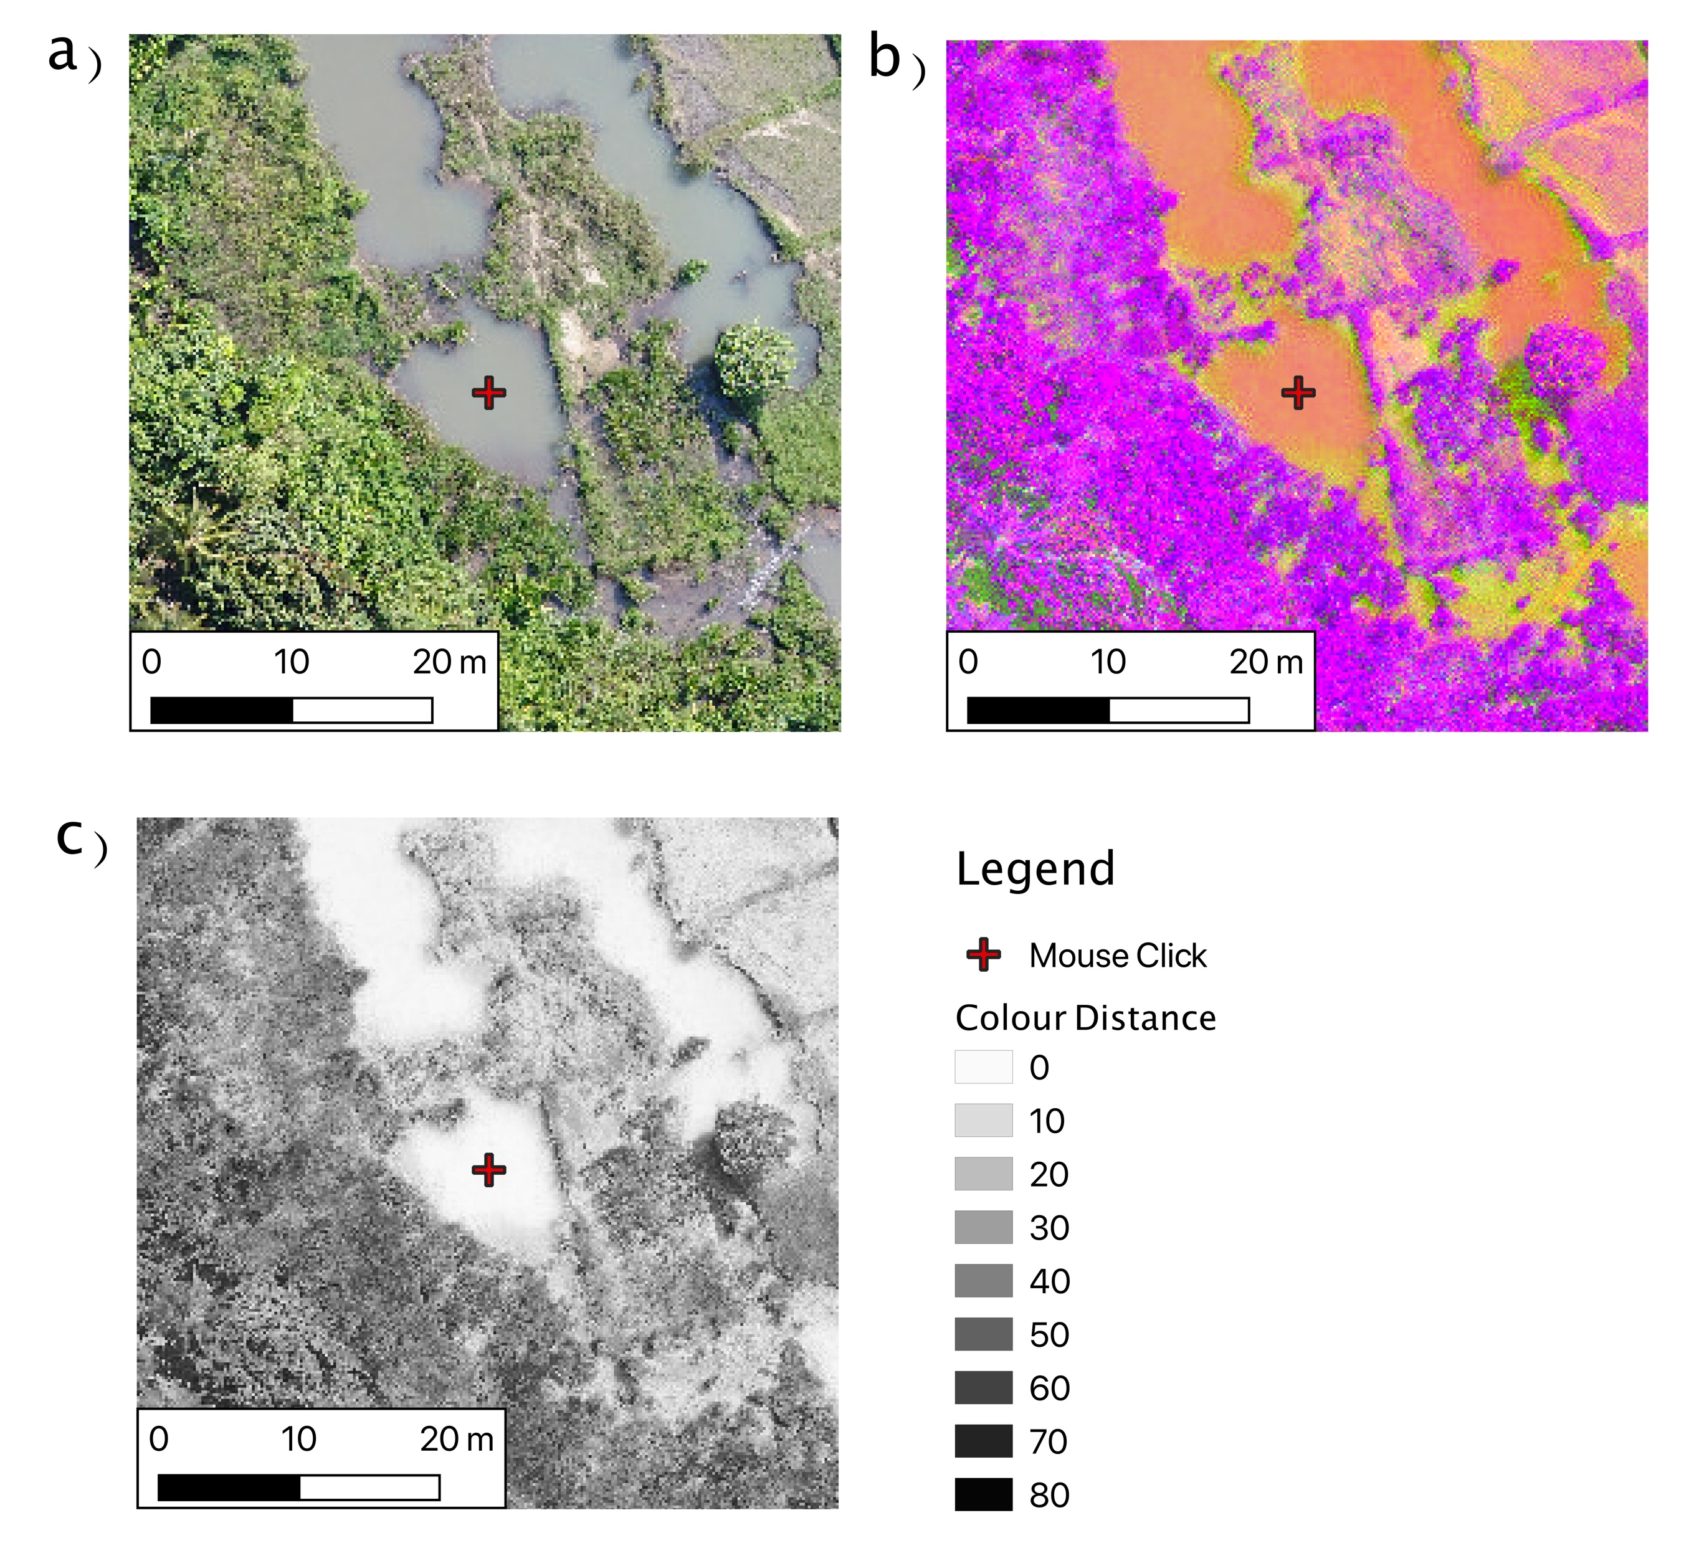
Principle Of Operation – Colour Distance
Pixels which have a similar colour will be expected to appear close to the user clicked pixel in the feature space.
These similar pixels will therefore have a low colour distance.
This is independent of where those pixels are spatially within the neighbourhood window.

Slide 9
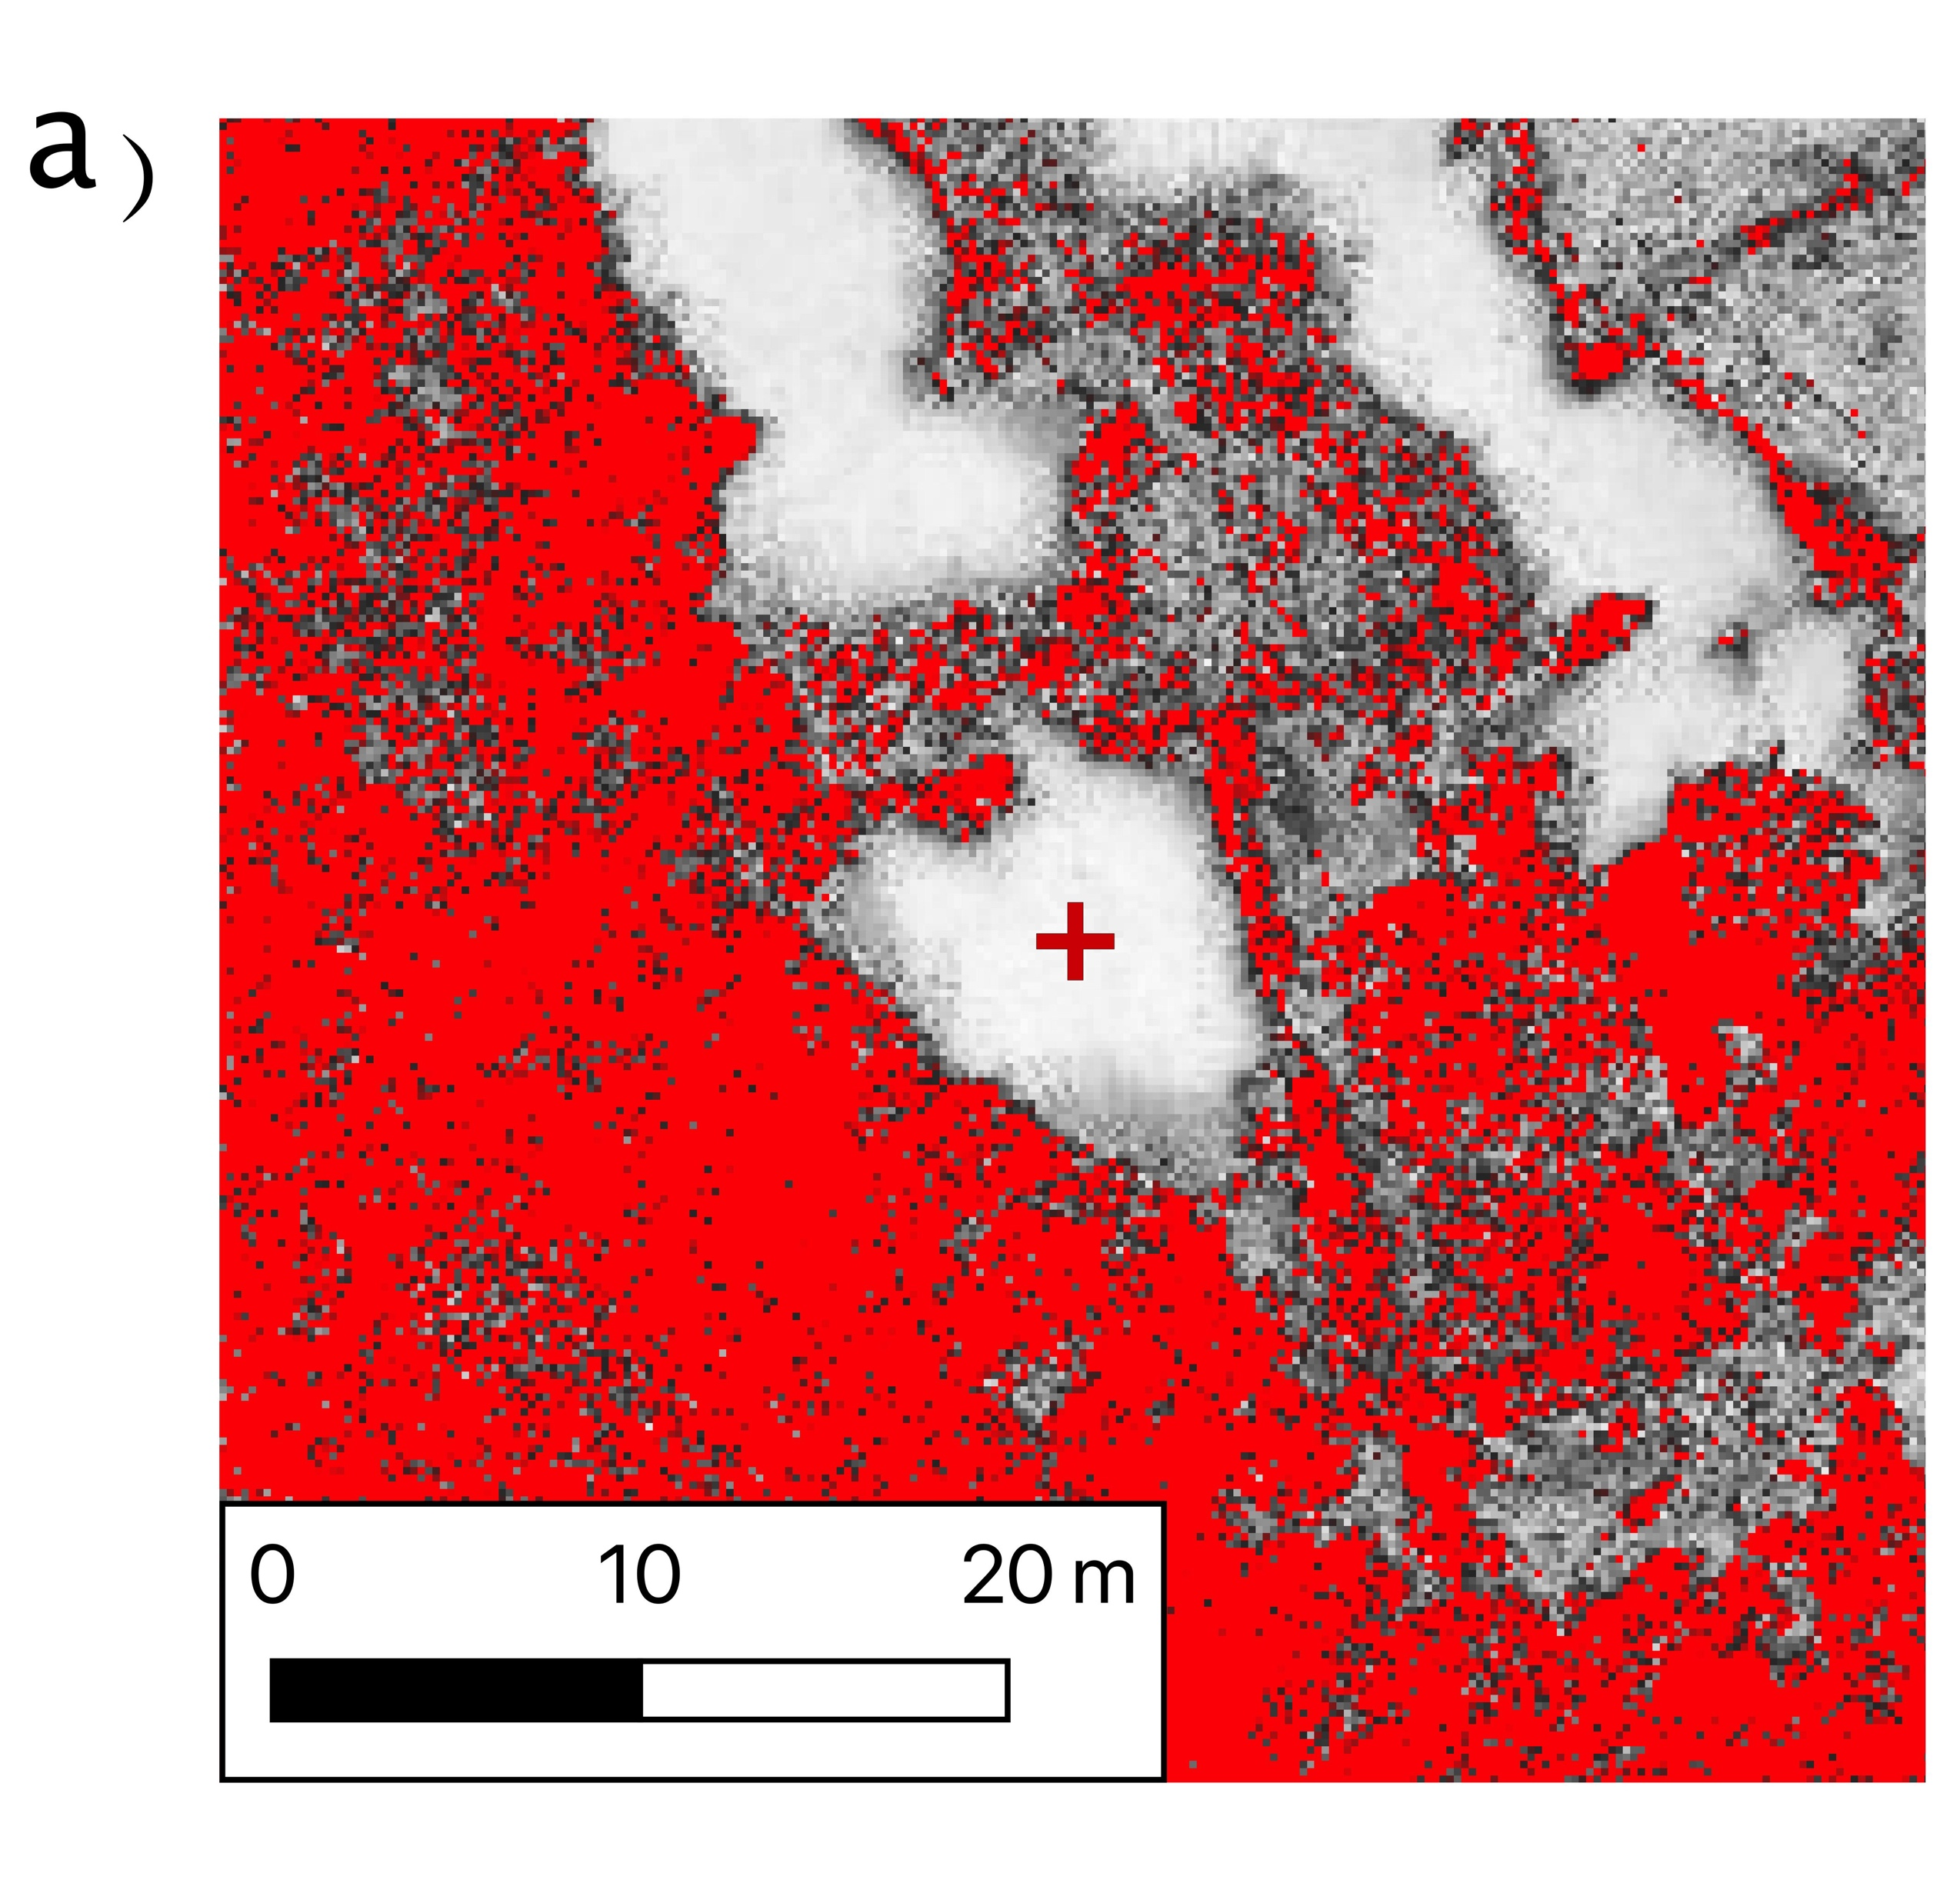
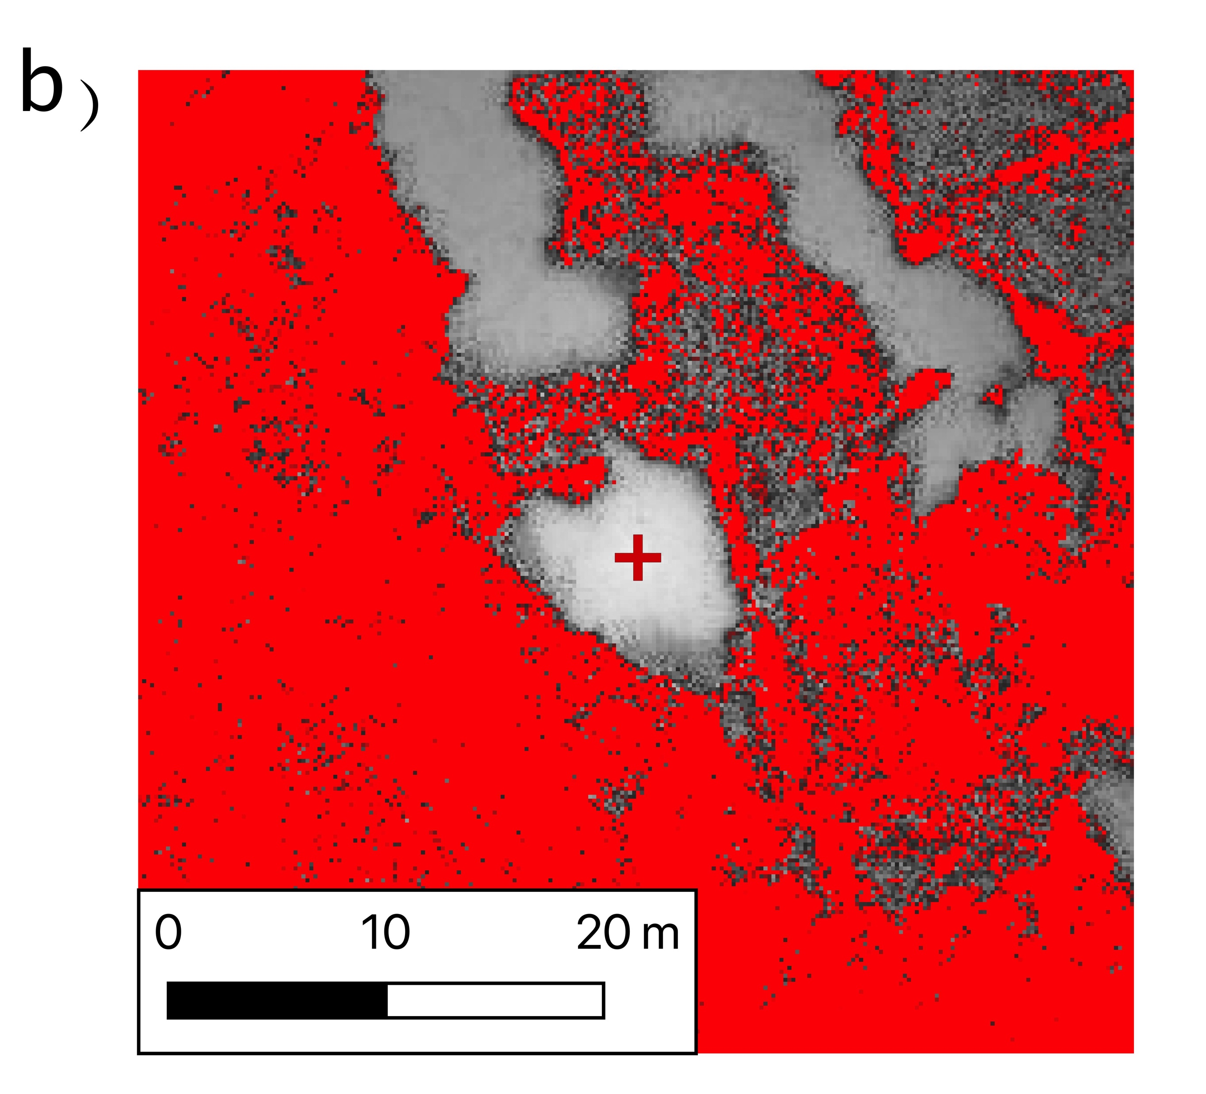
Principle Of Operation – Spatial Weighting
Pixels are spatially weighted based on far away they are from the user clicked pixel.
Pixels further away from the user’s click, which may be a similar colour but a different object have their colour distance increased.
Negatively Weighted Colour Distance

Slide 10
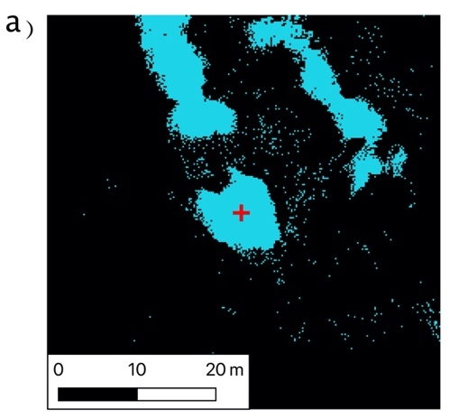
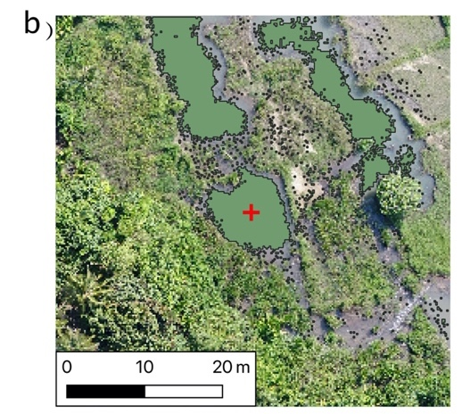
Principle Of Operation – Colour Distance Thresholding
The colour distance image has a user defined threshold applied to determine pixels which are similar after weighting.
This is then converted into a vector dataset of similarly coloured pixels.

Slide 11
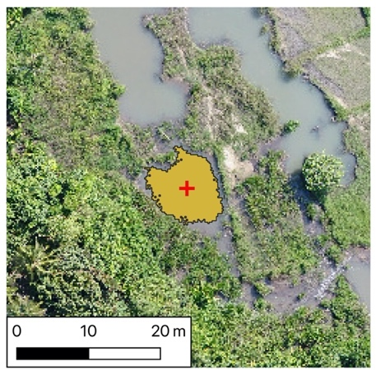
Principle Of Operation – Vector Dataset Intersection
The plugin will commonly identify many objects, containing similar pixels, as well as some single pixels.
To remove these an intersection is made between the user clicked point and the vector dataset.
These leaves a digitised feature at the location the user has clicked containing similarly coloured pixels.

Slide 12
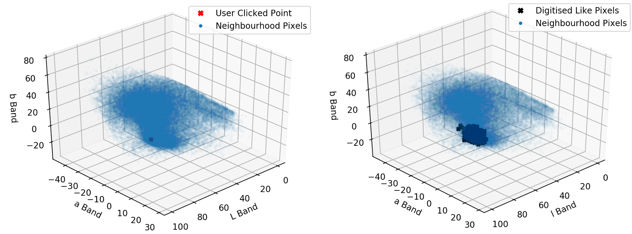
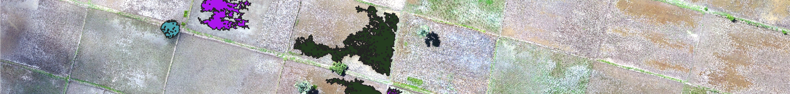
Identified Pixels in the LAB Feature Space
Pixels which have been digitised with the tool can be seen to cluster around the location of the user’s mouse click.

